Slide 1
Deep Portfolio Theory
Presented by: Jinyang Li; Linda Wu; Lina Wang
ACTSC 972 Midterm Project

Slide 2
INTRODUCTION
OVERVIEW
Deep portfolio theory builds on Markowitz’s classic risk-return trade-off and makes use of deep learning to construct portfolios.
It first encodes the market information and then decodes it to form a portfolio that is designed to achieve the goal.
It relies on deep factors which have a non-linear relationship to the input data.
Primary strength: avoid any statistical inputs such as expected returns or variance-covariance matrices.
Objective: It will formulate an automated and general portfolio selection process (4 steps): Auto-Encoding; Calibration; Validation; Verification.

Slide 3
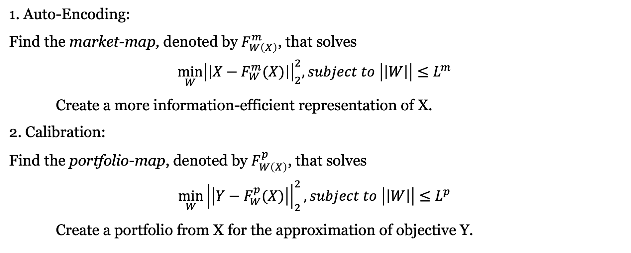
INTRODUCTION
4 STEPS
1. Auto-Encoding:
Find the market-map, denoted by $F_{W\left(X\right)}^{m}$, that solves
$$\min_{W}{{\left|\left|X−F_{W}^{m}(X)\right|\right|}_{2}^{2}, subject to \left|\left|W\right|\right|≤L^{m}}$$
Create a more information-efficient representation of X.
2. Calibration:
Find the portfolio-map, denoted by $F_{W\left(X\right)}^{p}$, that solves
$$\min_{W}{{\left|\left|Y−F_{W}^{p}(X)\right|\right|}_{2}^{2}, subject to \left|\left|W\right|\right|≤L^{p}}$$
Create a portfolio from X for the approximation of objective Y.

Slide 4
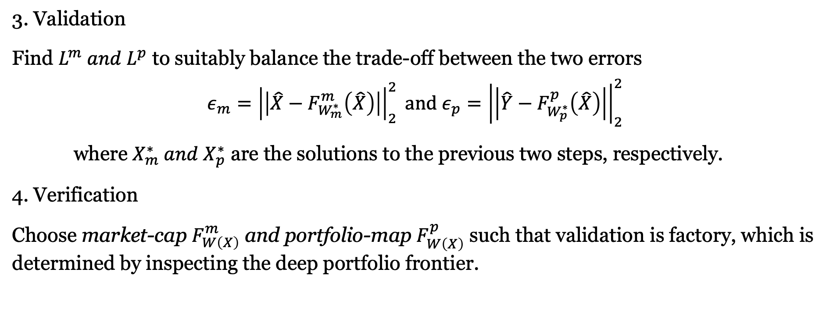
INTRODUCTION
4 STEPS
3. Validation
Find $L^{m} and L^{p}$ to suitably balance the trade-off between the two errors
$$ε_{m}={\left|\left|\hat{X}−F_{W_{m}^{∗}}^{m}\left(\hat{X}\right)\right|\right|}_{2}^{2} and ε_{p}={\left|\left|\hat{Y}−F_{W_{p}^{∗}}^{p}\left(\hat{X}\right)\right|\right|}_{2}^{2}$$
where $X_{m}^{∗} and X_{p}^{∗}$ are the solutions to the previous two steps, respectively.
4. Verification
Choose market-cap $F_{W\left(X\right)}^{m}$ and portfolio-map $F_{W\left(X\right)}^{p}$ such that validation is factory, which is determined by inspecting the deep portfolio frontier.

Slide 5
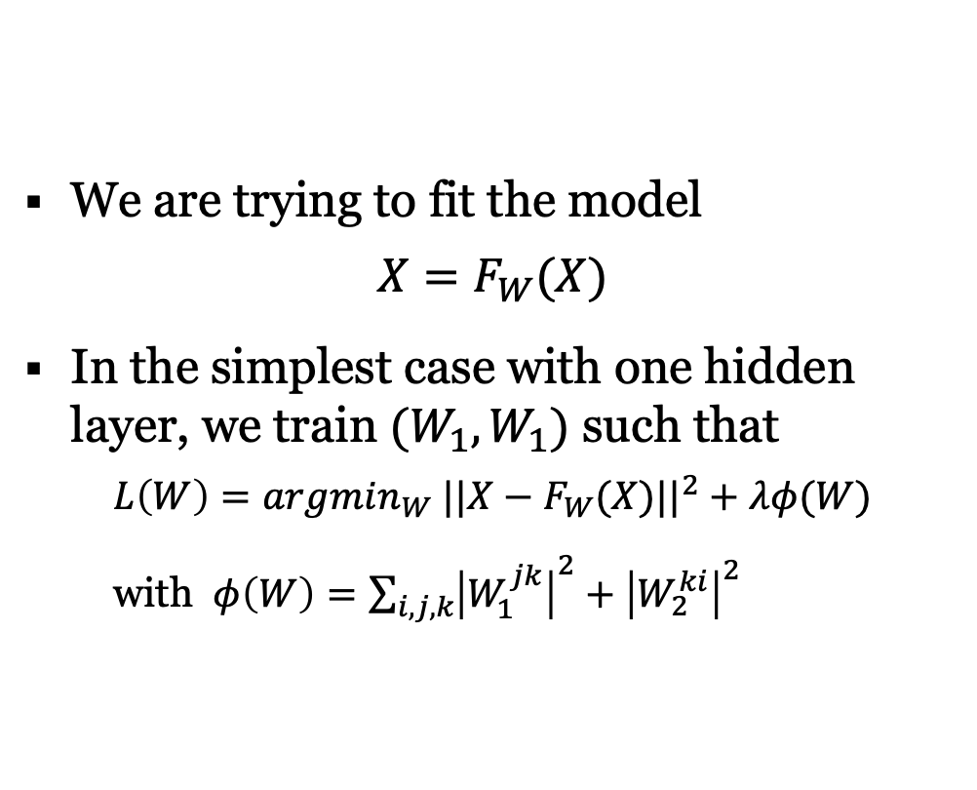
Introduction – Auto encoder
ARCHITECTURE
We are trying to fit the model
$$X=F_{W}(X)$$
In the simplest case with one hidden layer, we train $(W_{1},W_{1})$ such that
$$L\left(W\right)=argmin_{W} ||X−F_{W}(X)||^{2}+λφ(W)$$
with $φ\left(W\right)=\sum_{i,j,k}{{\left|W_{1}^{jk}\right|}^{2}+{\left|W_{2}^{ki}\right|}^{2}}$

Slide 6
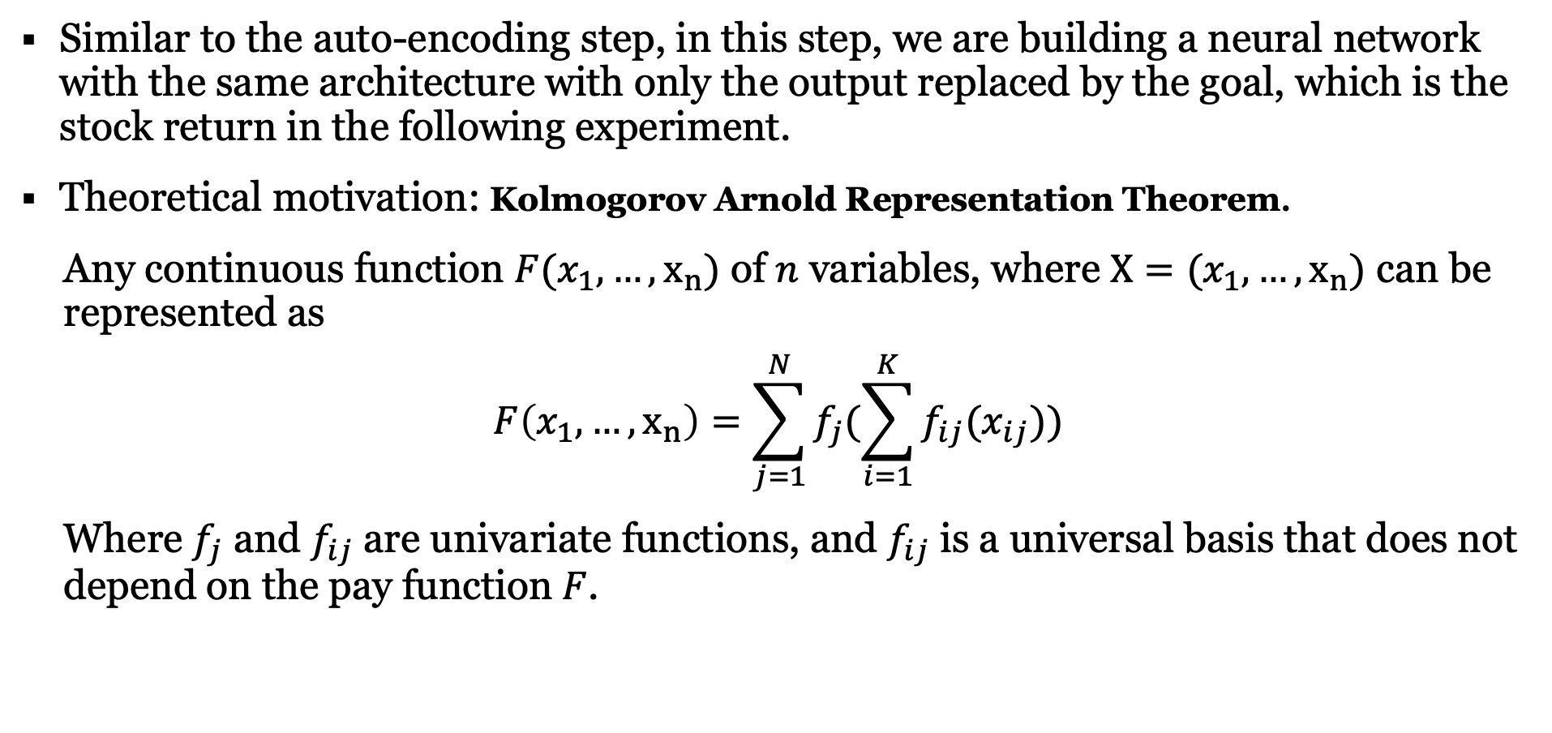
Introduction – traditional factor models
ARCHITECTURE
Similar to the auto-encoding step, in this step, we are building a neural network with the same architecture with only the output replaced by the goal, which is the stock return in the following experiment.
Theoretical motivation: Kolmogorov Arnold Representation Theorem.
Any continuous function $F(x_{1},…,x_{n})$ of $n$ variables, where $X=(x_{1},…,x_{n})$ can be represented as
$$F\left(x_{1},…,x_{n}\right)=\sum_{j=1}^{N}{f_{j}(\sum_{i=1}^{K}{f_{ij}(x_{ij})})}$$
Where $f_{j}$ and $f_{ij}$ are univariate functions, and $f_{ij}$ is a universal basis that does not depend on the pay function $F$.

Slide 7
NUMERICAL EXPERIMENT
The paper has retraced the IBB Index as an numerical example. The goal is to find a small selection of stocks for which a deep portfolio structure with good out-of-sample tracking properties can found.
In our project, we are retracing the IVW Index by applying the deep portfolio theory.
IVW tracks an index of large-cap US stocks. The index selects stocks with growth characteristics from the S&P 500 Index.
Number of holdings as of 10/29/2019: 297 stocks
We have successfully replicated the four steps in the paper with satisfied result achieved, with each step being discussed in detail one by one next.

Slide 8
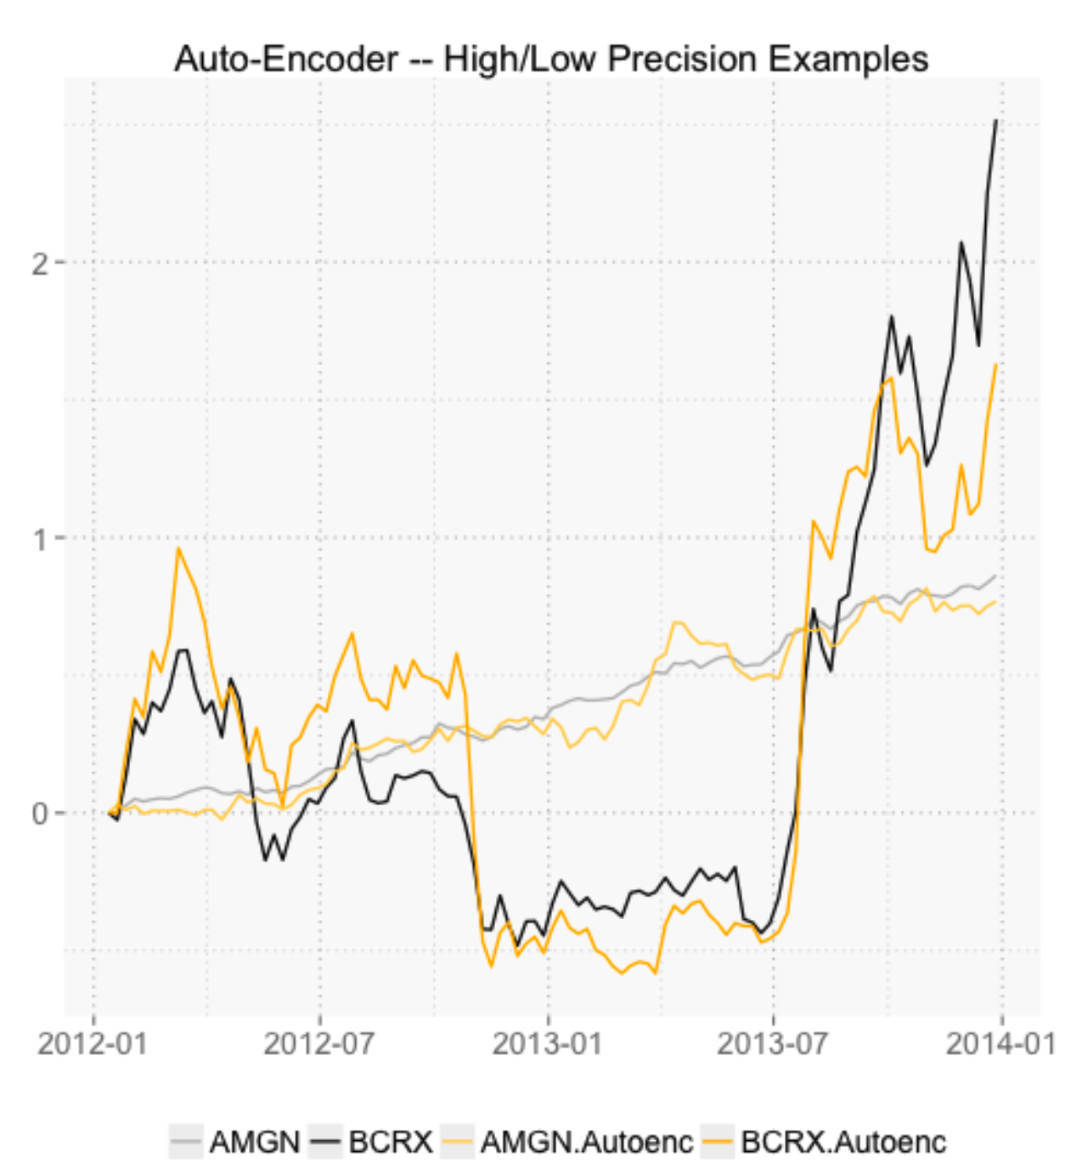
Auto-Encoding

Slide 9
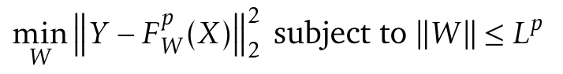
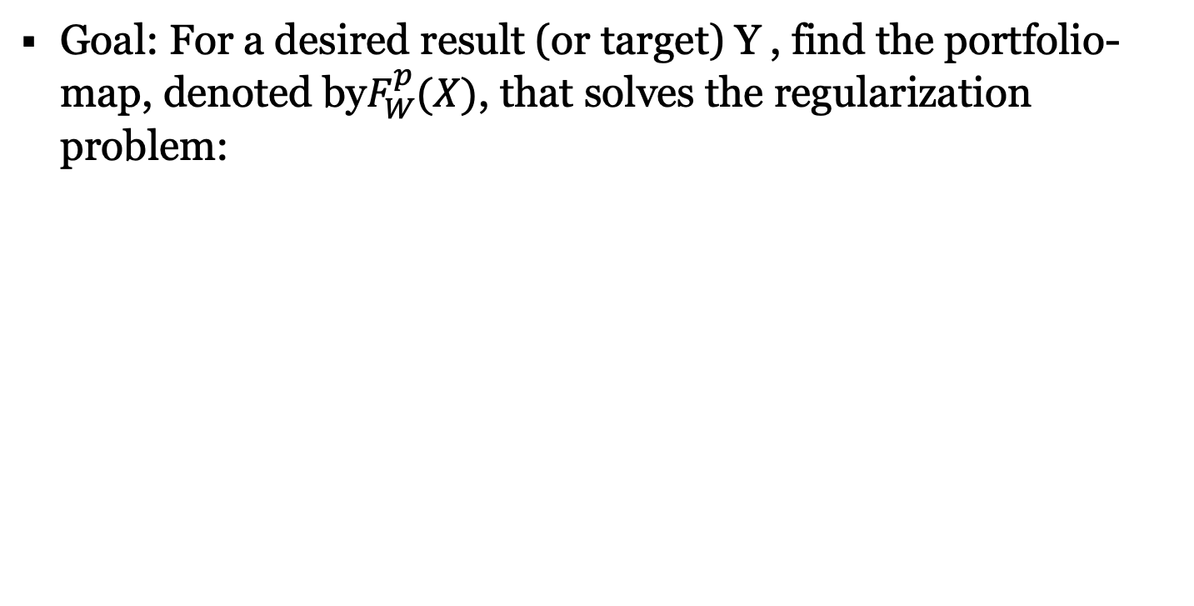
Calibration
Goal: For a desired result (or target) Y , find the portfolio-map, denoted by$F_{W}^{p}(X)$, that solves the regularization problem:

Slide 10
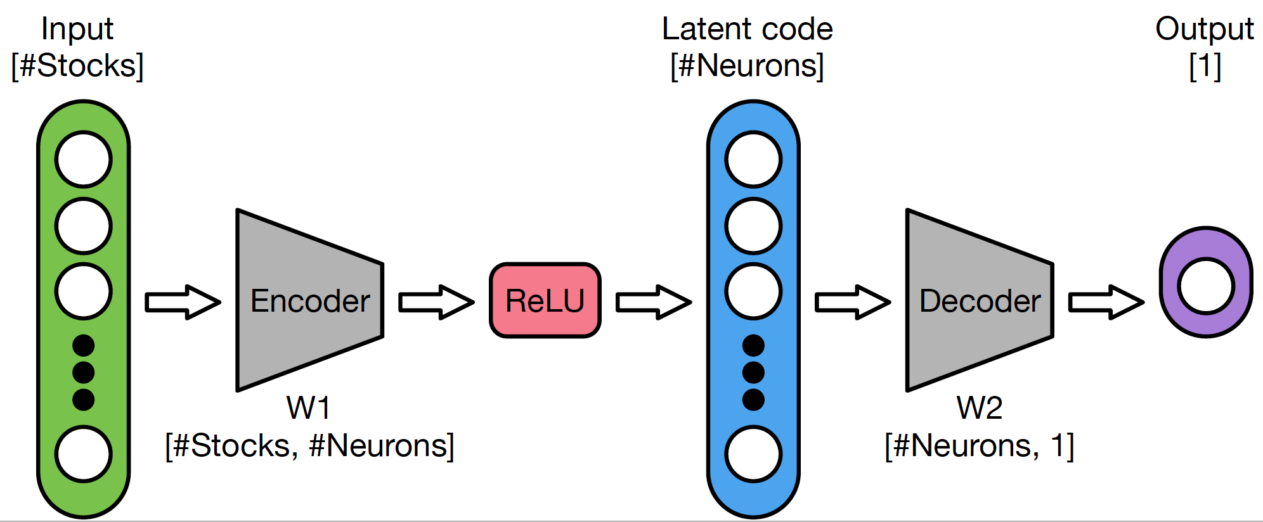
Calibration

Slide 11
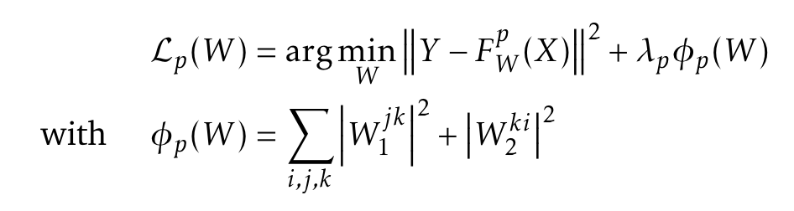
Calibration
In our implementation

Slide 12
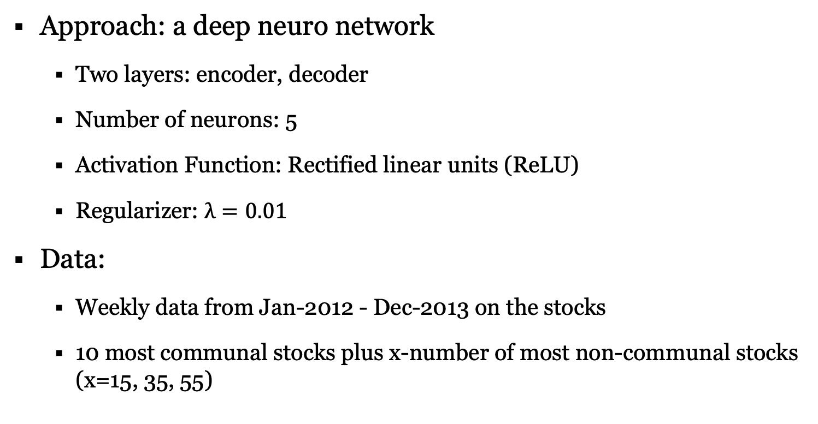
Calibration
Approach: a deep neuro network
Two layers: encoder, decoder
Number of neurons: 5
Activation Function: Rectified linear units (ReLU)
Regularizer: $λ=0.01$
Data:
Weekly data from Jan-2012 - Dec-2013 on the stocks
10 most communal stocks plus x-number of most non-communal stocks (x=15, 35, 55)

Slide 13
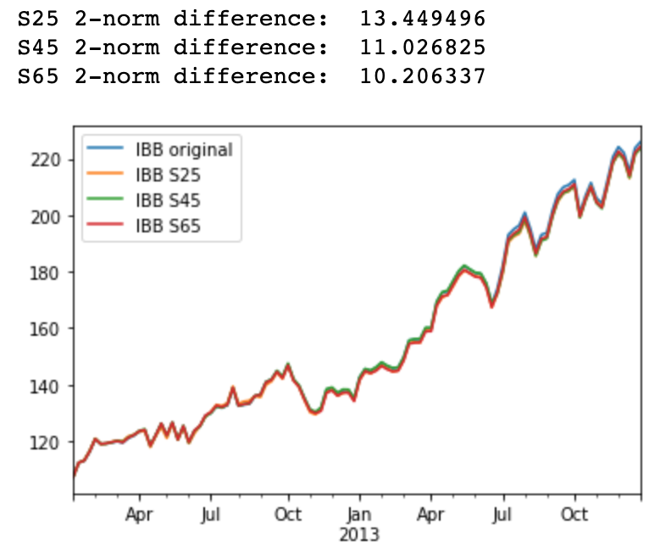
Calibration
Result:

Slide 14
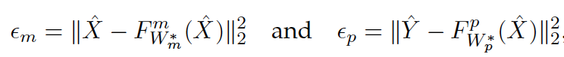
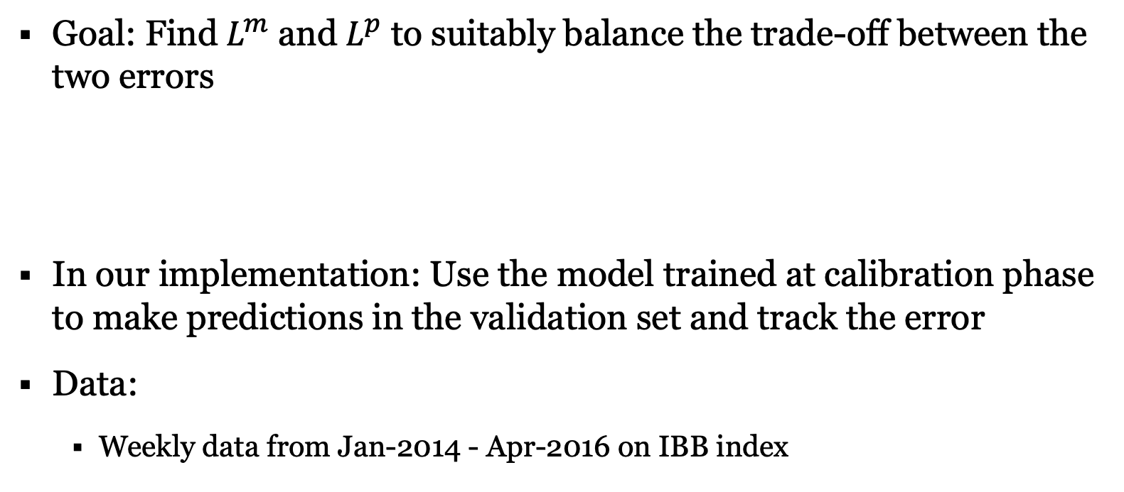
Validation
Goal: Find $L^{m}$ and $L^{p}$ to suitably balance the trade-off between the two errors
In our implementation: Use the model trained at calibration phase to make predictions in the validation set and track the error
Data:
Weekly data from Jan-2014 - Apr-2016 on IBB index

Slide 15
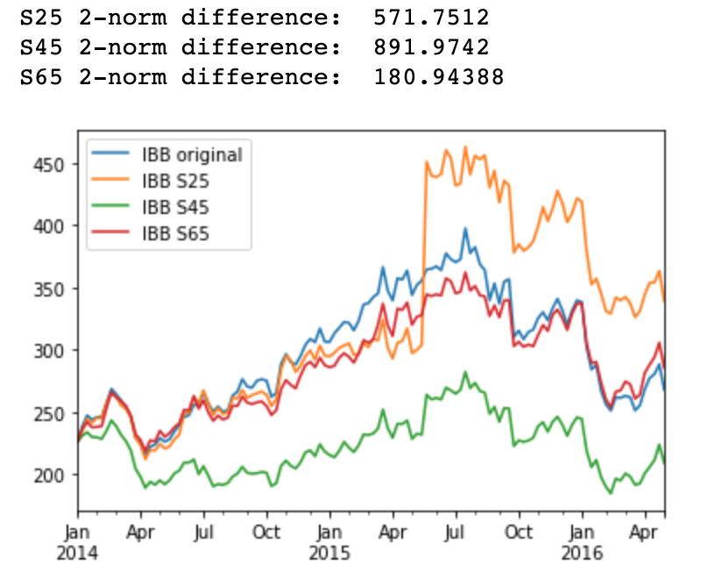
Validation
Result:

Slide 16
Alternative Data Set: IVW
Calibration Phase:
Include 15 most communal stocks (communal degree: 3.12 to 7.61)
Increase the number of neurons from 5 to 16
Extend the training data set: daily data from Jan-2014 to Dec-2017
Change the number of tracking stocks accordingly

Slide 17
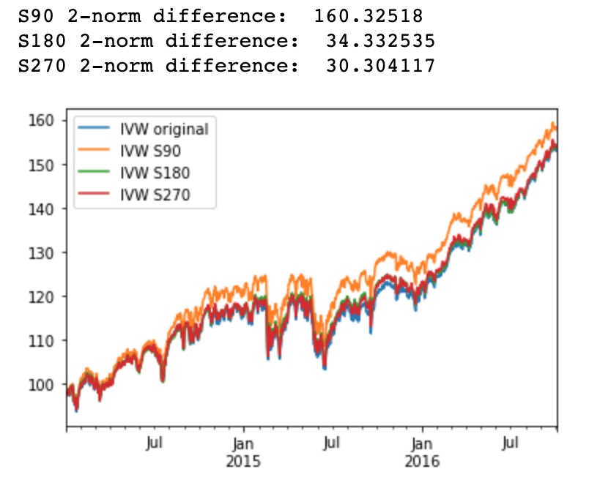
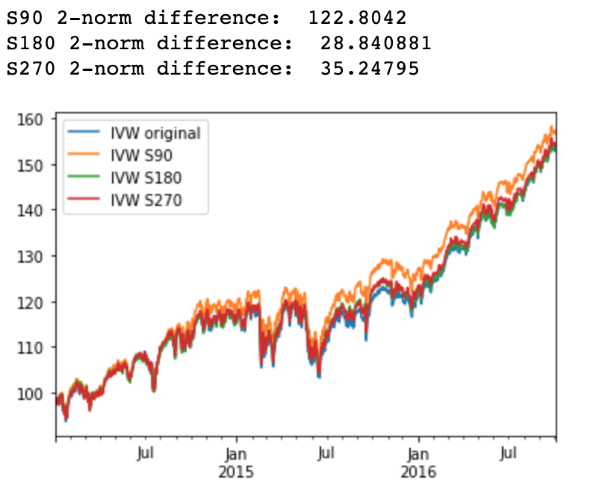
Alternative Data Set: IVW
Result:
# of neurons = 64

Slide 18
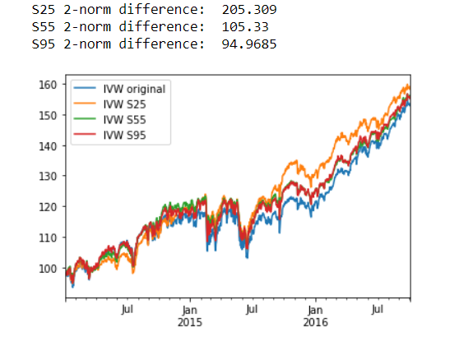
Alternative Data Set: IVW

Slide 19
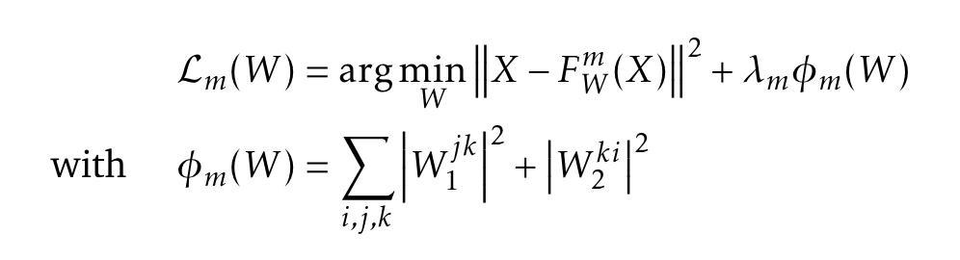
Alternative Data Set: IVW
Validation Phase:
Train models with different regularizes in the calibration phase:
For encoding phase:
For calibration phase:

Slide 20
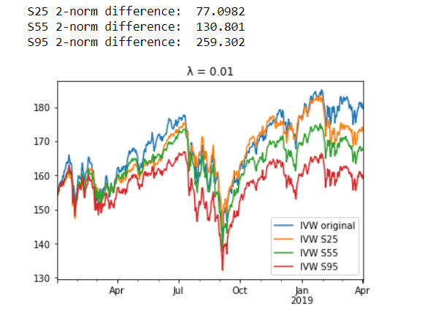
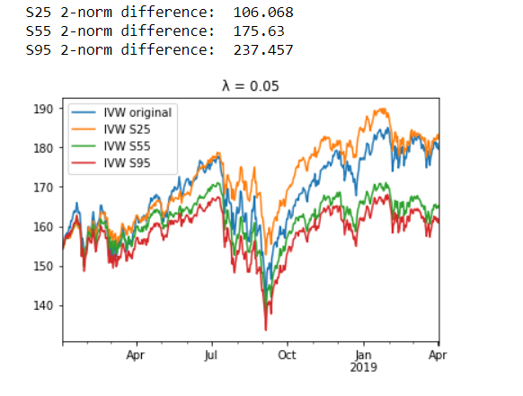
Alternative Data Set: IVW
Result:

Slide 21
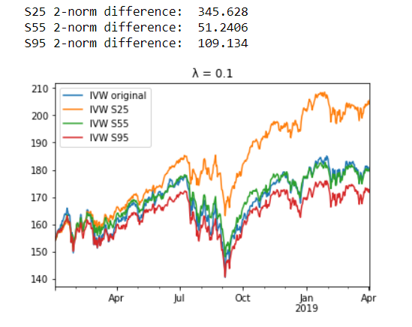
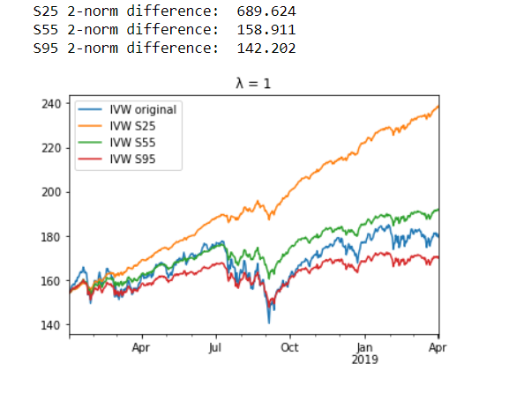
Alternative Data Set: IVW

Slide 22
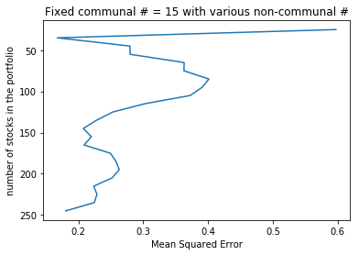
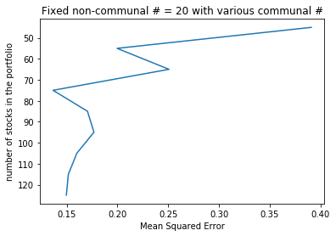
Verification
Verifying the chosen number of stocks
Estimating the accuracy of selected approach using different number of stocks

Slide 23
Summary
The authors developed a four-step routine of encode, calibrate, validate and verify for portfolio selection.
The large data set of historical returns were encoded and reduced to an information subset, and then decoded to achieve a pre-specified goal.
An appropriate amount of regularization was chosen to optimize the out-of-sample performance.
(Not shown in slides) In order to beat the index return, the authors amended the target index data during the calibration phase.

Slide 24
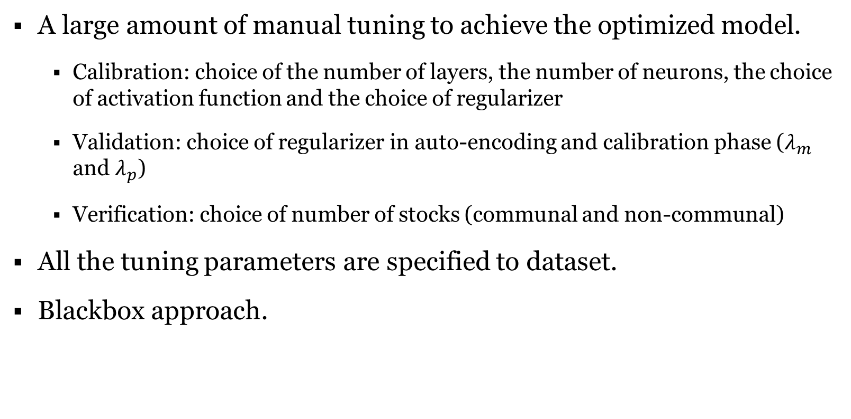
Critical Assessment/Limitations
A large amount of manual tuning to achieve the optimized model.
Calibration: choice of the number of layers, the number of neurons, the choice of activation function and the choice of regularizer
Validation: choice of regularizer in auto-encoding and calibration phase ($λ_{m}$ and $λ_{p}$)
Verification: choice of number of stocks (communal and non-communal)
All the tuning parameters are specified to dataset.
Blackbox approach.

Slide 25
Reference
J. Heaton, N.G. Polson and J.H. Witte, Deep learning for finance: deep portfolios, Appl. Stochastic Models Bus. Ind. 2017, 33 3–12.
J. Heaton, N.G. Polson and J.H. Witte, Deep Portfolio Theory, arXiv:1605.07230v1, revised 23 May 2016.

